Slide 1

Pressure Testing: 20.10.23
JHP

Slide 2
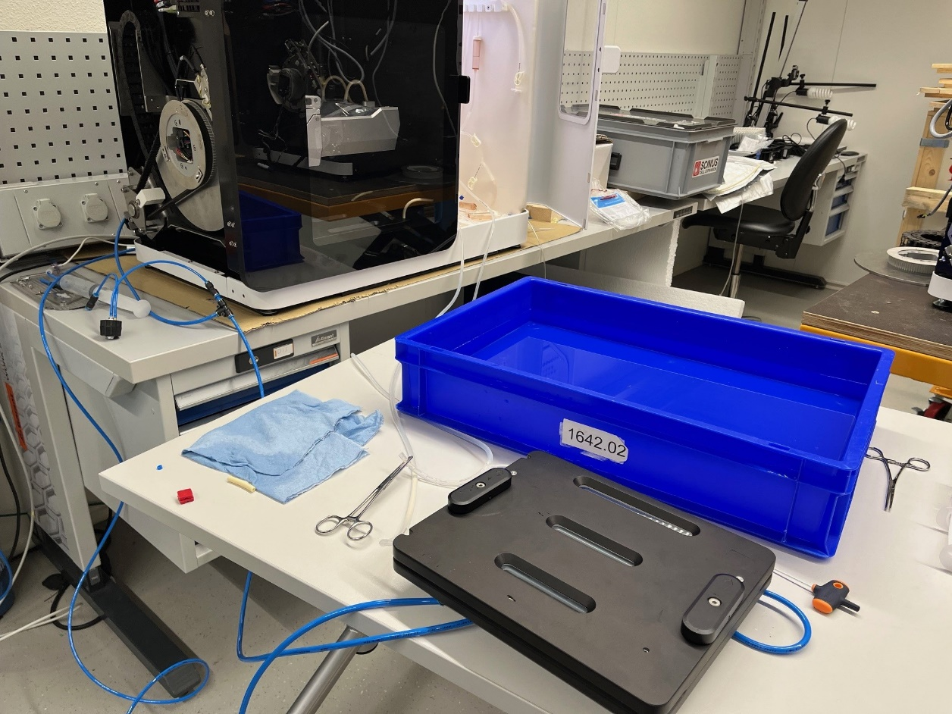
Setup
Flow reducer: GPRO-10
Water box for leakage detection
Oxygenator A from 001 Alpha (used, even overtightened, etc.)
Oxygenator B from new series of 5

Slide 3
Flow reducer GPRO-10
Notice: MFC is used with curves for O2/N2/CO2 altough air is used
Oxygenator is shortcutted and only MFC + GPRO-10 is measured
@10ml/min for two different GPRO-10 result in the same pressures
Relevant settings tested:
  Setting 5: ~48mbar
  Setting 6: ~110mbar
  Setting 7: ~250mbar

Slide 4
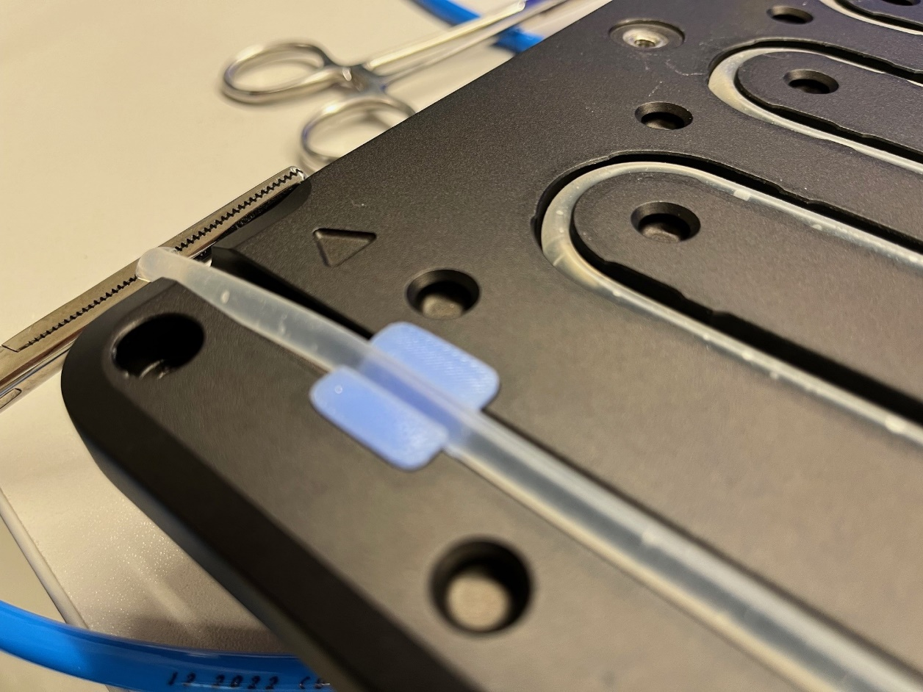
Location of leakage
Testing with 10ml/min and Oxy A; channels pH and DO are connected as well as „vent“; bigger blue grommet is used at outlet
  Location of leakage is inlet and outlet with ca. 10 bubbles/min
  Pressure 75mbar (of 90mbar)
  Having Oxy in water does not make any difference

Slide 5
Avoid leakage
Same setup as above; grommets are configured to stick out 1mm
  Pressure 90mbar (same as without Oxy)
  Very low leakage of 3 bubbles/min
  Issue: Permeable tube collapses

Slide 6
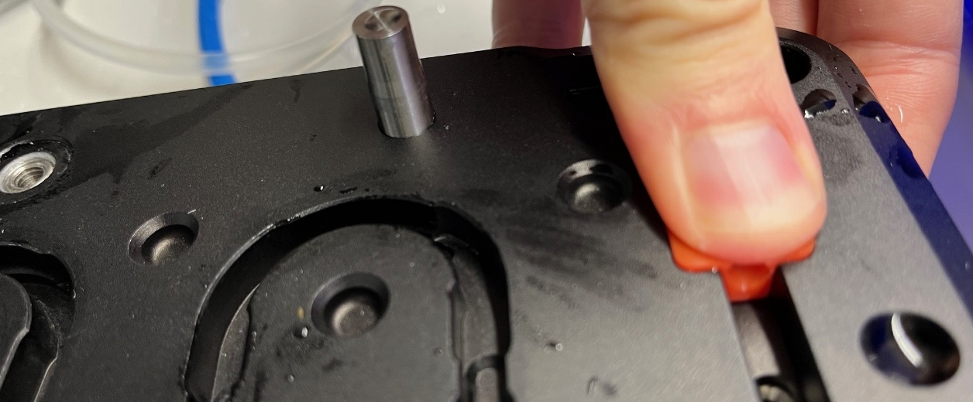
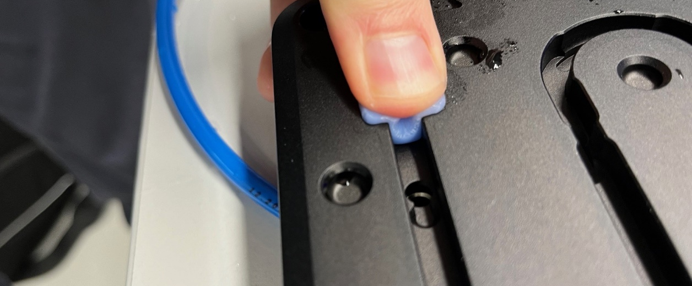
Grommets
Trying different grommets with a running oxygenator loop
  Bigger (and softer) blue grommets don‘t improve sealing when taking working perfusion loop into account. I.e. permeable tube collapses at similar pressures as with red grommet.

Slide 7
Permable tube collapse
Permeable tube collapses only after pressure build-up in the oxygenator and some time
This starts to happen at around 50-60mbar (depending of course on the grommets sticking out and the tightening of the Oxy)

Slide 8
Comparison with current system
Red machine is operated at around 40ml/min resulting in 30mbar
Current target was 100mbar at 10ml/min which seams unfeasable with current grommet sealing solution. More sealing force is needed but permeable tube can‘t withstand
Reduce target to 50mbar at 10ml/min with a reducer setting of about 5.2
Still better performance than current system and seems feasable

